Slide 1

CSC 2302/DSCI 1302 Python Basics (cont.), Object Oriented Programing (OOP)

Slide 2
Built-in function print(), revisited
Introduction to Computing Using Python
their string representation
Function print() takes 0 or more arguments and prints them in the shell
>>> prod = 'morels'
>>> cost = 139
>>> wght = 1/2
>>> total = cost * wght
>>>
>>> prod = 'morels'
>>> cost = 139
>>> wght = 1/2
>>> total = cost * wght
>>> print(prod, cost, wght, total)
morels 139 0.5 69.5
>>>
>>> prod = 'morels'
>>> cost = 139
>>> wght = 1/2
>>> total = cost * wght
>>> print(prod, cost, wght, total)
morels 139 0.5 69.5
>>> print(prod, cost, wght, total, sep='; ')
morels; 139; 0.5; 69.5
>>>
>>> prod = 'morels'
>>> cost = 139
>>> wght = 1/2
>>> total = cost * wght
>>> print(prod, cost, wght, total)
morels 139 0.5 69.5
>>> print(prod, cost, wght, total, sep='; ')
morels; 139; 0.5; 69.5
>>> print(prod, cost, wght, total, sep=':::')
morels:::139:::0.5:::69.5
>>>
A blank space separator is printed between the arguments
The sep argument allows for customized separators

Slide 3
Built-in function print(), revisited
Introduction to Computing Using Python
Function print() prints, by default, a newline character after printing its arguments
>>> pets = ['boa', 'cat', 'dog']
>>> for pet in pets:
print(pet)
boa
cat
dog
>>>
>>> pets = ['boa', 'cat', 'dog']
>>> for pet in pets:
print(pet)
boa\n
cat\n
dog\n
>>>
>>> pets = ['boa', 'cat', 'dog']
>>> for pet in pets:
print(pet)
boa
cat
dog
>>> for pet in pets:
print(pet, end=', ')
boa, cat, dog,
>>>
>>> pets = ['boa', 'cat', 'dog']
>>> for pet in pets:
print(pet)
boa
cat
dog
>>> for pet in pets:
print(pet, end=', ')
boa, cat, dog,
>>> for pet in pets:
print(pet, end='!!! ')
boa!!! cat!!! dog!!!
>>>
The end argument allows for customized end characters

Slide 4
General output formatting
Introduction to Computing Using Python
Suppose we have
>>> weekday = 'Wednesday'
>>> month = 'March'
>>> day = 10
>>> year = 2010
>>> hour = 11
>>> minute = 45
>>> second = 33
and we want to print Wednesday, March 10, 2010 at 11:45:33

Slide 5
Method format() of class str
Introduction to Computing Using Python
>>> weekday = 'Wednesday'
>>> month = 'March'
>>> day = 10
>>> year = 2012
>>> hour = 11
>>> minute = 45
>>> second = 33
>>> print('{}:{}:{}'.format(hour, minute, second))
11:45:33
>>> print('{}, {} {}, {} at {}:{}:{}'.format(weekday, month, day, year, hour, minute, second))
Wednesday, March 10, 2012 at 11:45:33
format string
print('{}:{}:{}'.format(hour, minute, second))

Slide 6
Specifying field width
Introduction to Computing Using Python
>>> for i in range(1,8):
print(i, i**2, 2**i)
1 1 2
2 4 4
3 9 8
4 16 16
5 25 32
6 36 64
7 49 128
>>> for i in range(1, 8):
print('{} {:2} {:3}'.format(i, i**2, 2**i))
1 1 2
2 4 4
3 9 8
4 16 16
5 25 32
6 36 64
7 49 128
>>>
The format() method can be used to line up data in columns
>>> for i in range(1,8):
print(i, i**2, 2**i)
1 1 2
2 4 4
3 9 8
4 16 16
5 25 32
6 36 64
7 49 128
>>>
Numbers are aligned to the right
reserves 2 spaces for i**2
reserves 3 spaces for 2**i

Slide 7
Specifying field width
Introduction to Computing Using Python
The format() method can be used to line up data in columns
>>> lst = ['Alan Turing', 'Ken Thompson', 'Vint Cerf']
>>> for name in lst:
fl = name.split()
print(fl[0], fl[1])
Alan Turing
Ken Thompson
Vint Cerf
>>> for name in lst:
fl = name.split()
print(‘{:<5} {:<10}'.format(fl[0], fl[1]))
Alan Turing
Ken Thompson
Vint Cerf
>>>
>>> lst = ['Alan Turing', 'Ken Thompson', 'Vint Cerf']
>>> for name in lst:
fl = name.split()
print(fl[0], fl[1])
Alan Turing
Ken Thompson
Vint Cerf
>>>
Numbers are aligned to the right
Strings are aligned to the left

Slide 8
Output format type
Introduction to Computing Using Python
Inside the curly braces of a placeholder, we can specify the field width
Inside the curly braces of a placeholder, we can specify the field width, the type of the output
Inside the curly braces of a placeholder, we can specify the field width, the type of the output, and the decimal precision
>>> n = 10
>>> '{:b}'.format(n)
'1010'
>>> '{:c}'.format(n)
'\n'
>>> '{:d}'.format(n)
'10'
>>> '{:X}'.format(n)
'A'
>>> '{:e}'.format(n)
'1.000000e+01'
>>>
>>> n = 10
>>> '{:b}'.format(n)
'1010'
>>> '{:c}'.format(n)
'\n'
>>> '{:d}'.format(n)
'10'
>>> '{:X}'.format(n)
'A'
>>> '{:e}'.format(n)
'1.000000e+01'
>>> '{:7.2f}'.format(n)
' 10.00'
>>>
Type | Explanation
b | binary
c | character
d | decimal
X | hexadecimal
e | scientific
f | fixed-point
'{:7.2f}'
field width
decimal precision

Slide 9
CSC 2302/DSCI 1302 Object Oriented Programming

Slide 10
Object-oriented programming
Object-oriented programming is a programming is based on the concept of "objects".
An object consists of –
- data fields
- procedures/operations/functions
A common feature of objects is that procedures are attached to them and can access and modify the object's data fields.
Notes:
Users can build programs from the standard modules that communicate with each other. This prevents writing the code again from scratch, which ultimately saves the development time of the code and therefore is higher productivity of the program.Ju

Slide 11
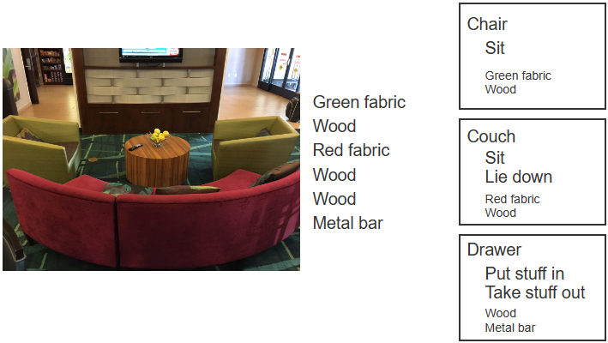
Objects
The world consists of items such as wood, metal, fabric, etc.
But people think in terms of higher-level objects, like chairs, couches, and drawers.
In fact, people think mostly of the operations that can be done with the objects.
For a drawer, operations include putting stuff in and taking stuff out.

Slide 12
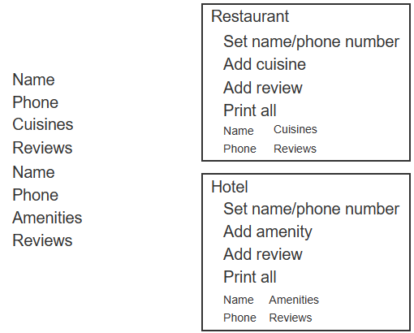
Objects
A program consists of variables and functions or methods
In OOP, programs are not viewed as variables and functions/methods but as objects.
An object is a grouping of data (variables) and related operations
Programmers may prefer to think of higher-level objects such as restaurants and hotels
Benefits of OOP – more understandable and manageable programs

Slide 13
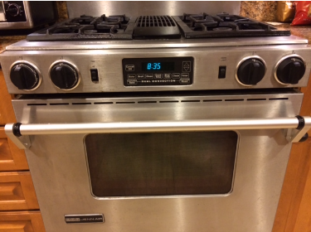
Abstraction / Information Hiding
Abstraction occurs when a user interacts with an object at a high level
Allowing lower-level internal details to remain hidden (aka information hiding or encapsulation)
Objects support abstraction by hiding entire groups of functions and variables and exposing only certain functions to a user.

Slide 14
Why Abstraction / Information Hiding?
Abstraction simplifies our world
E.g. An oven is viewed as having a compartment for food and a knob is turned to heat the food.
People need not be concerned with an oven's internal workings
Objects strongly support abstraction or information hiding.
The object's internal data, and possibly other operations, are hidden from the user.

Slide 15
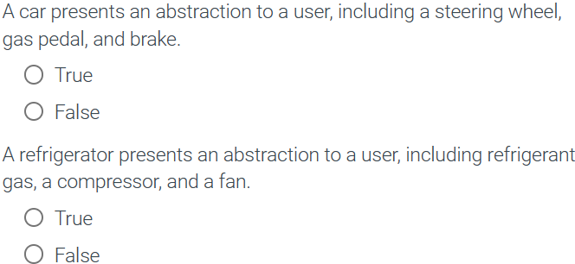


Slide 16
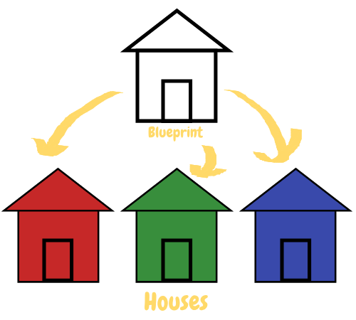
Class
Class House
A blueprint for creating objects
Defines the structure and behavior of objects
Doesn't usually contain the data
Supports Abstraction
Red
House
Blue
House
Objects
Green
House
Image: https://tutorials.supunkavinda.blog/static/images/php-oop-object-houses.png

Slide 17
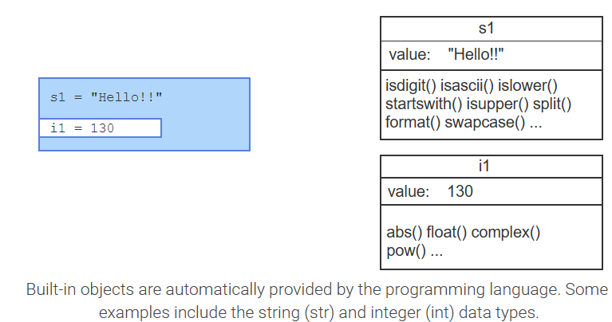
Python built-in objects
A programmer always interacts with built-in objects when writing Python code.

Slide 18
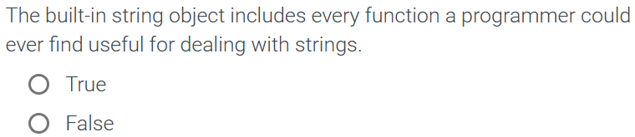

Slide 19
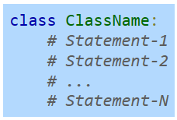
Classes: Grouping data
Classes - groups of related variables and functions
Creating a class in python: The class keyword can be used to create a class containing groups of related variables and functions.
Good practice is to use initial capitalization for each word in a class name

Slide 20
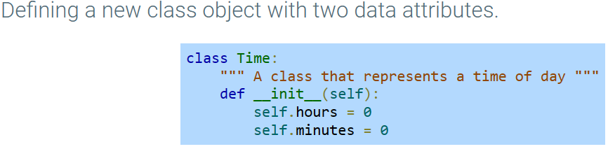
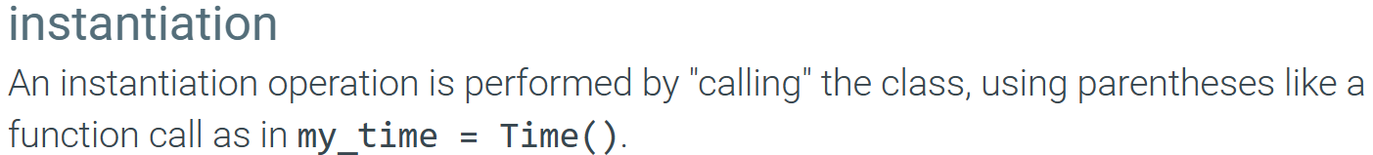
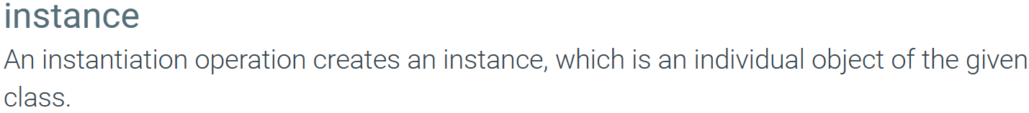
Classes: Grouping data
The object maintains a set of attributes that determines the data and behavior of the class.

Slide 21
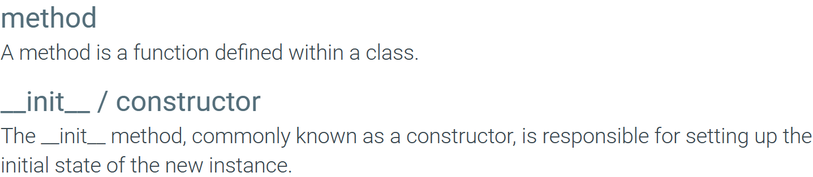
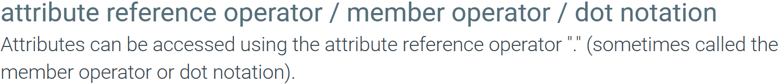
Classes: Grouping data

Slide 22
Classes: Coding Demo
Create a class named ‘Address’ (data – street and apt/unit)
Write the constructor method
Create an instance ‘work’ of the ‘Address’ class
Set street=‘1 Park Place’ and unit=‘Room 724’
Print the street and unit of the ‘work’ object

Slide 23
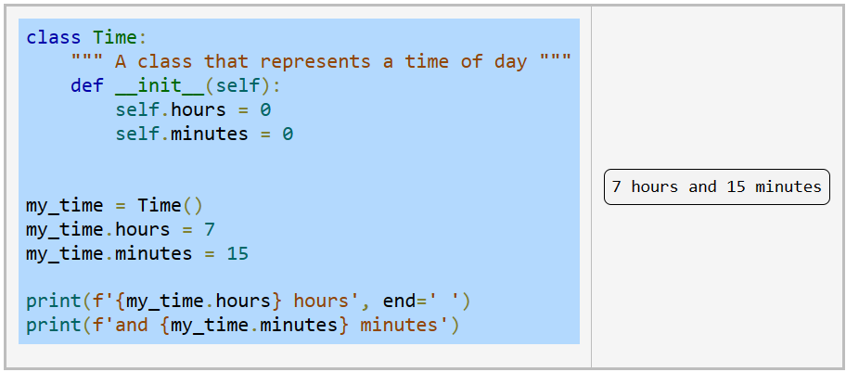
Classes: Grouping data
Using instantiation to create a variable using the Time class

Slide 24
Classes: Grouping data
Instantiation?
Constructor?
Member operator?
Using instantiation to create a variable using the Time class

Slide 25
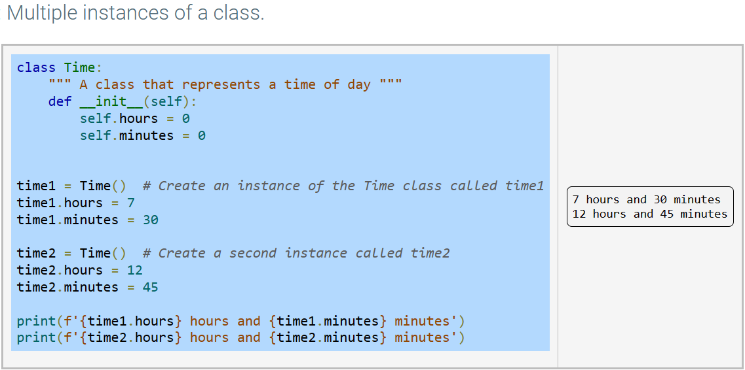
Classes: Grouping data

Slide 26
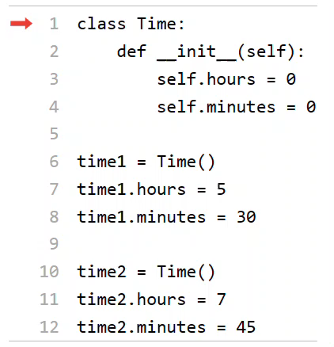
Classes: Grouping data
Initialization of object instances
Demonstration

Slide 27
Suggested Reading (ZyBook):
9.1 Classes: Introduction
9.2 Classes: Grouping Data

